Slide 1
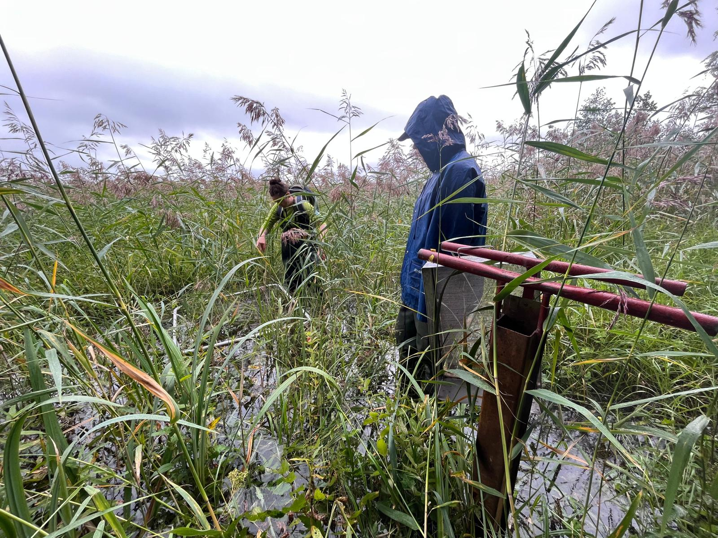
Common Reed (Phragmites australis) and the Baltic Sea: An Overview
Margo Williamson
14.02.2024

Slide 2
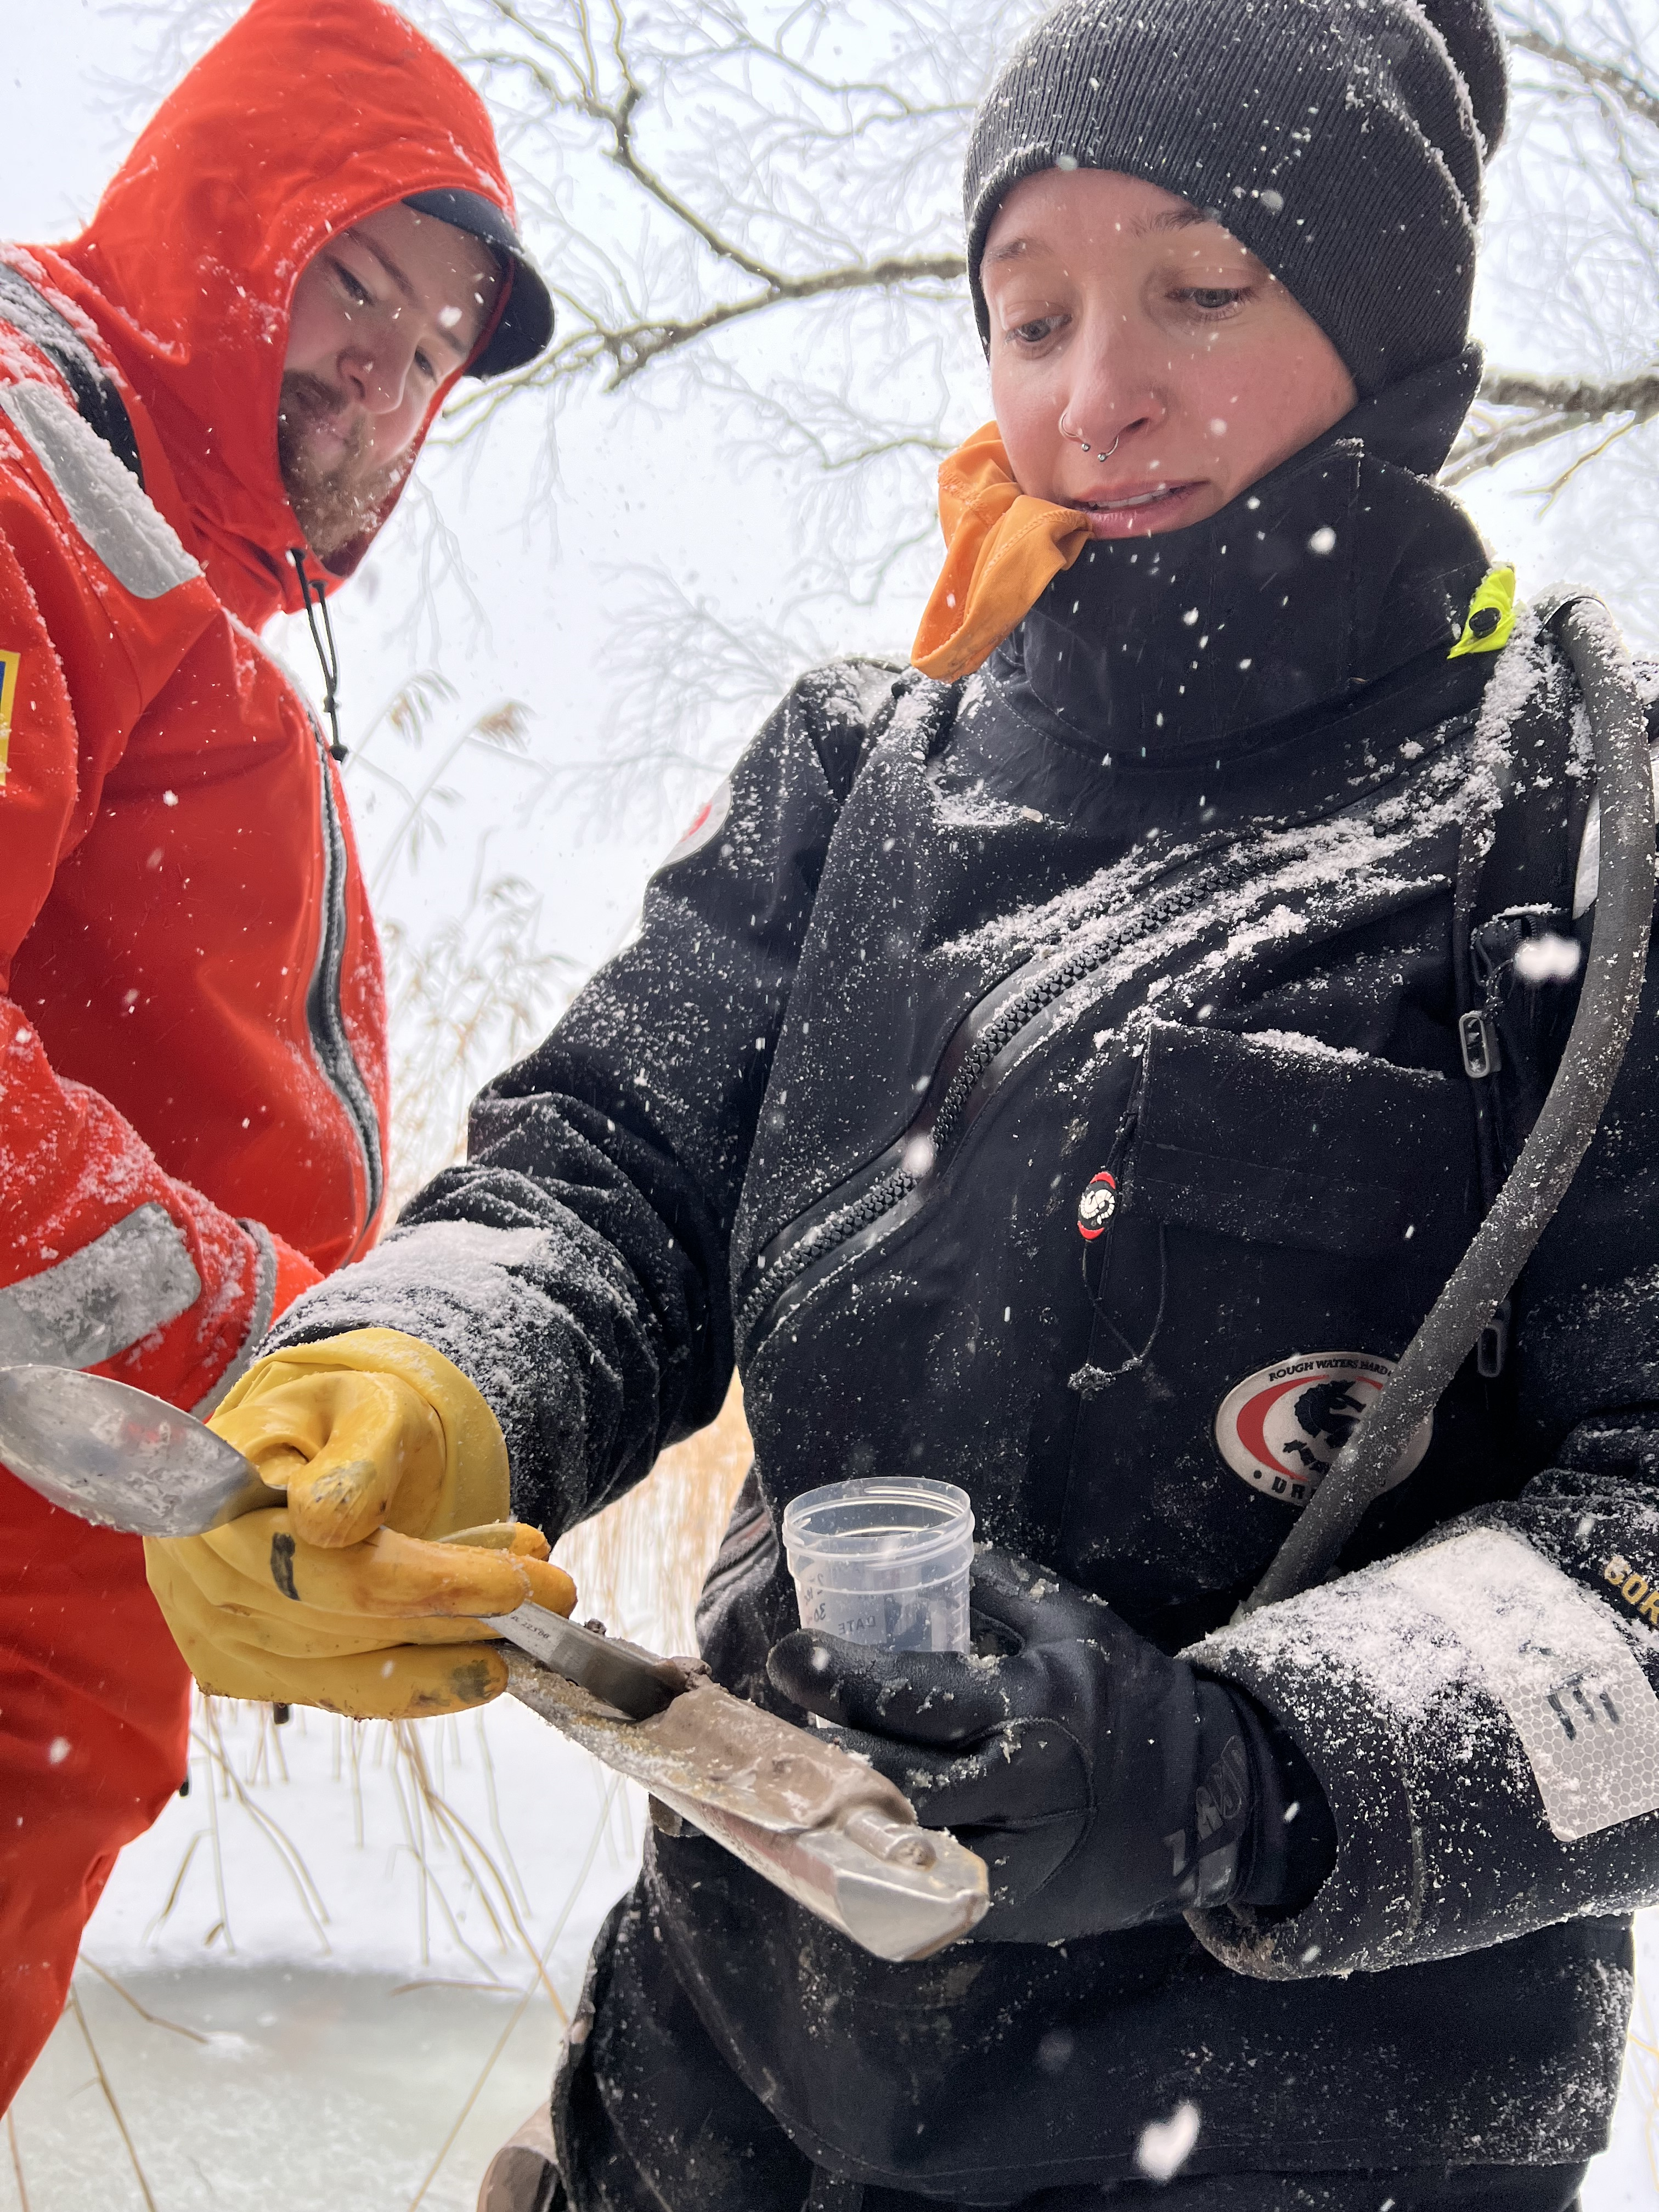
Intro: Margo Williamson
Coastal Ecologist
Bachelor of Science in Conservation Biology (coastal wetland biogeochemistry)
Master of Science in Groundwater Hydrology (potential for contaminant to move through soils into groundwater in coastal ecosystems)
Previous work and studies in the eastern US, Thailand, South America, and Alaska
Current Doctoral Researcher at UHel – TZS in Littoral Ecology (carbon cycling in reed beds across coastal systems in Finland)

Slide 3
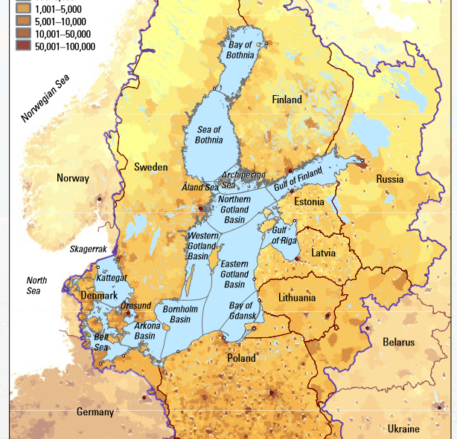
Baltic Sea
Brackish (lower salinity than most seas)
Surrounded mostly by land (huge amount of marine pollution actually from human activity on land)
These make the Baltic particularly sensitive to human impacts and eutrophication (increased nutrient levels)

Slide 4
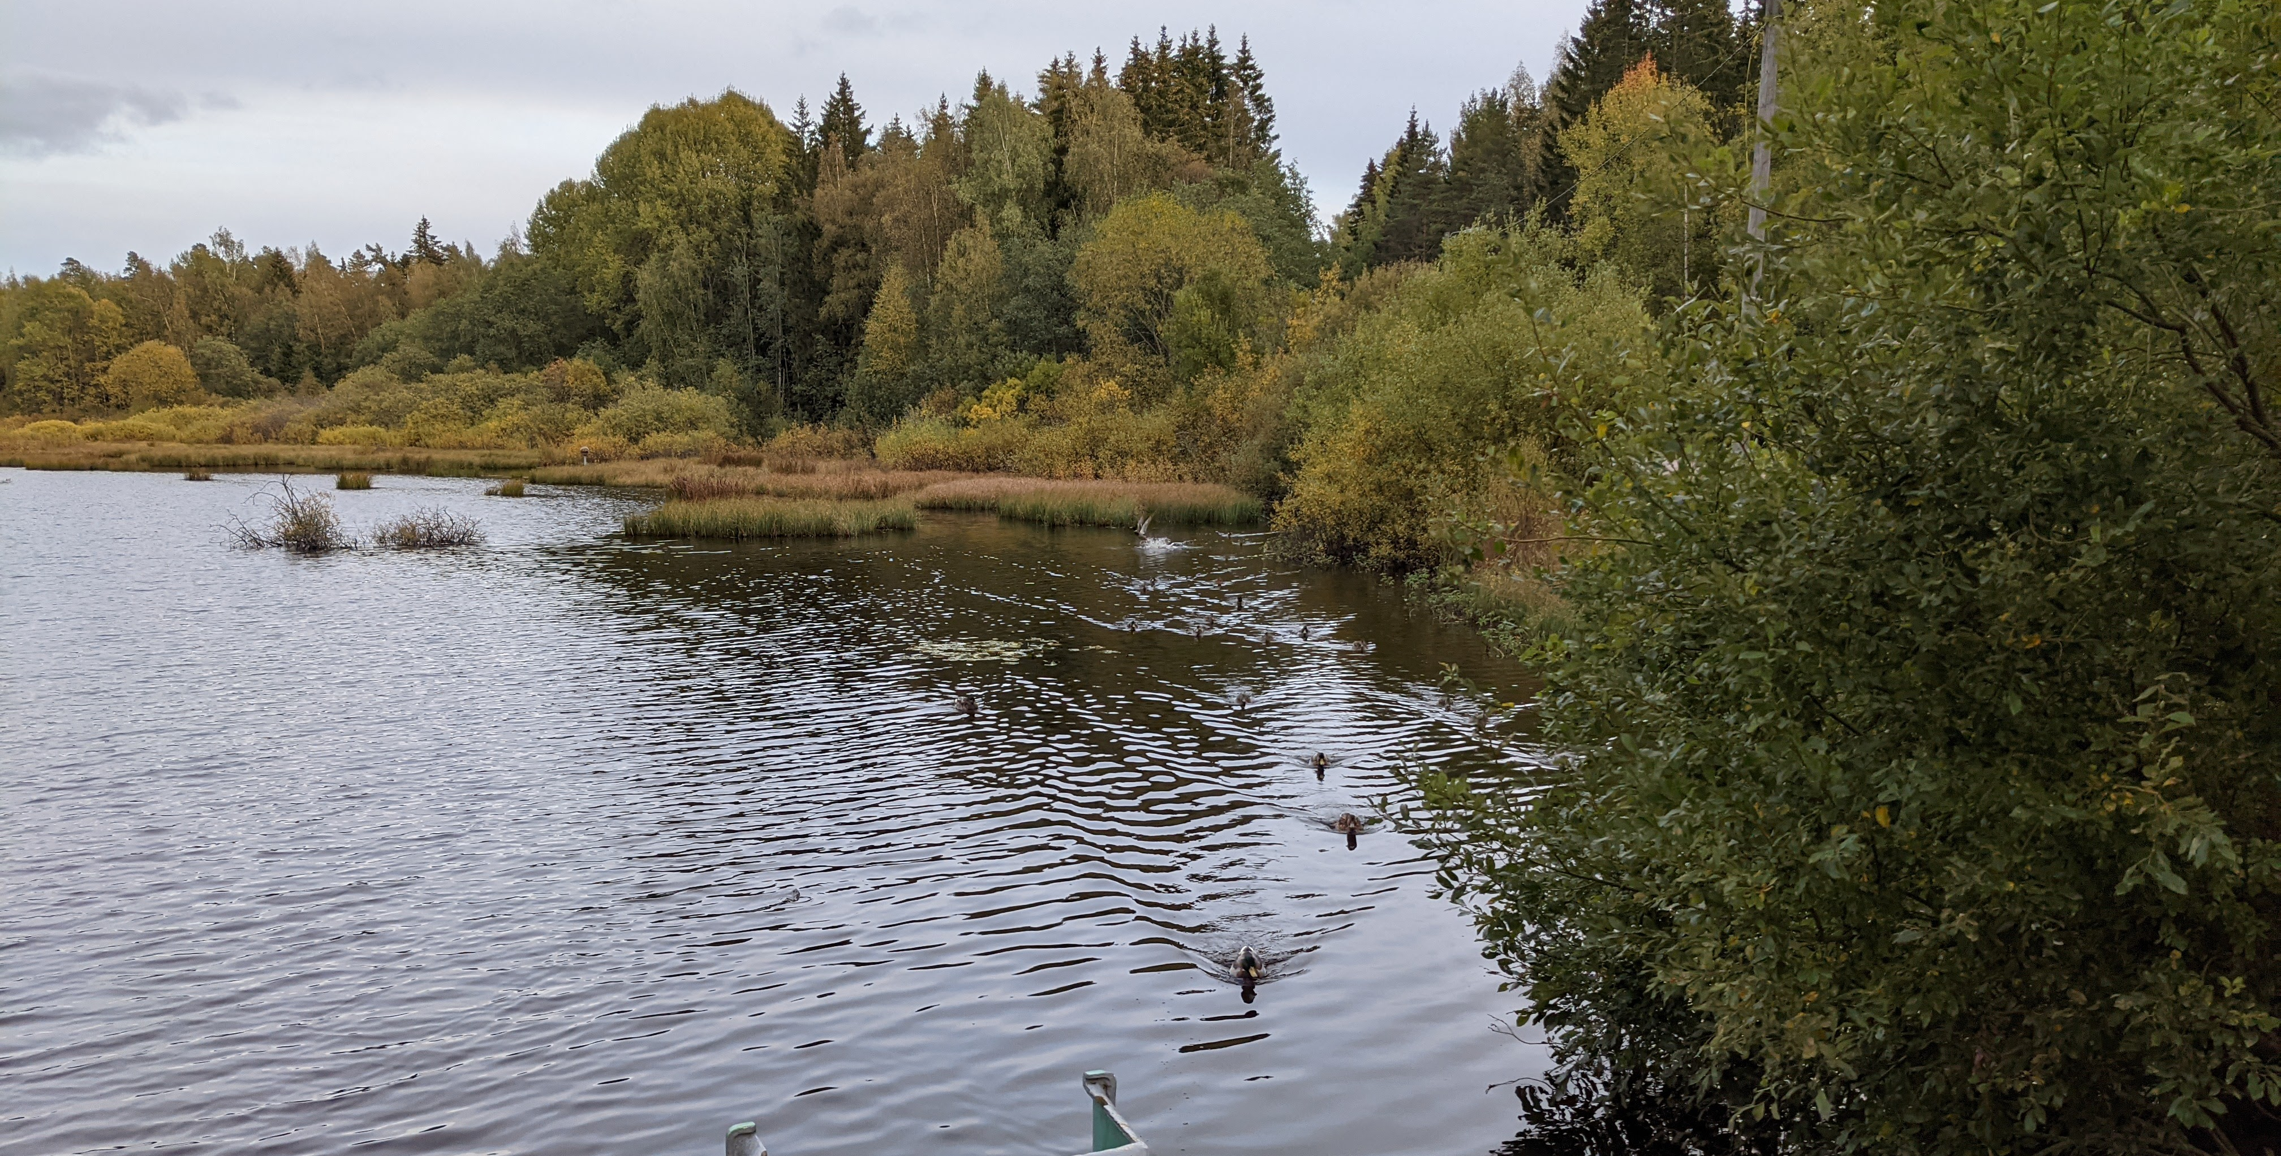
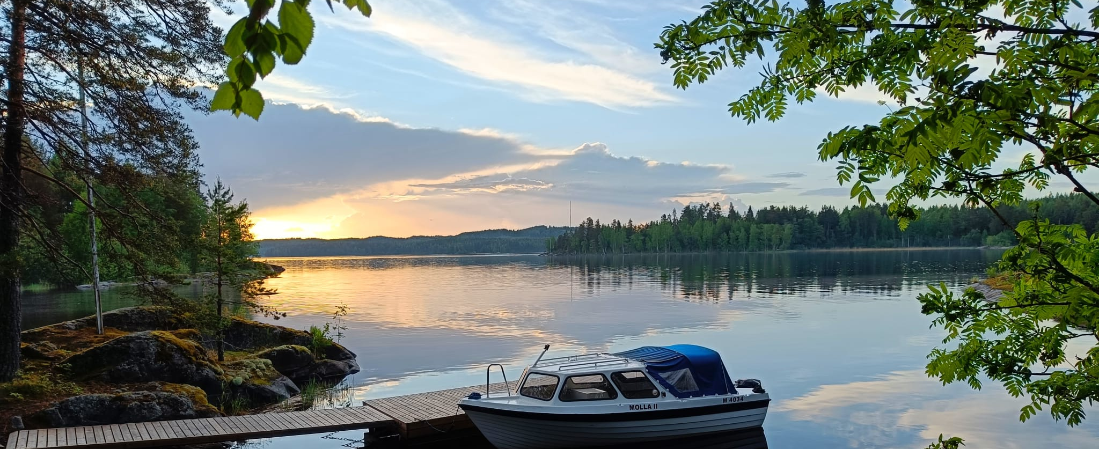
Coastal Ecosystems
Vegetated coastlines are important for a variety of reasons!
Storm buffers
Nesting habitat for waterfowl, migrating birds, fish, etc
Contaminant/nutrient collection from runoff before it enters a waterway
Recreational activities (fishing, birding, etc)

Slide 5
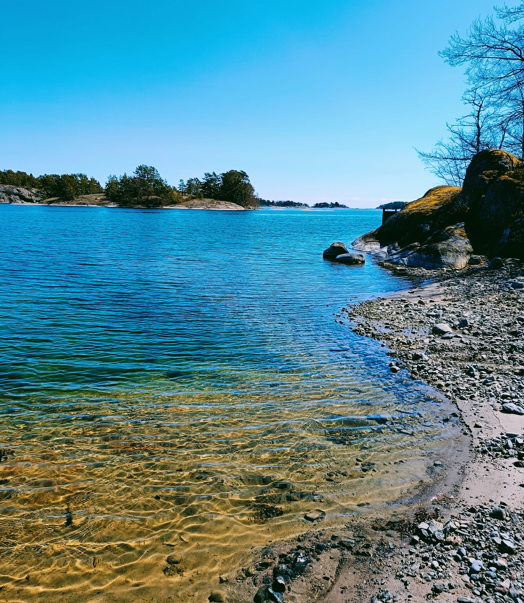
Coastal Ecosystems of Finland
Coastal gravel, shingle, and boulder shores
Coastal sand beaches and dunes
Coastal meadows
Coastal reedbeds
Drift lines and organic material
Coastal scrubs and forests
Coastal habitat complexes

Slide 6
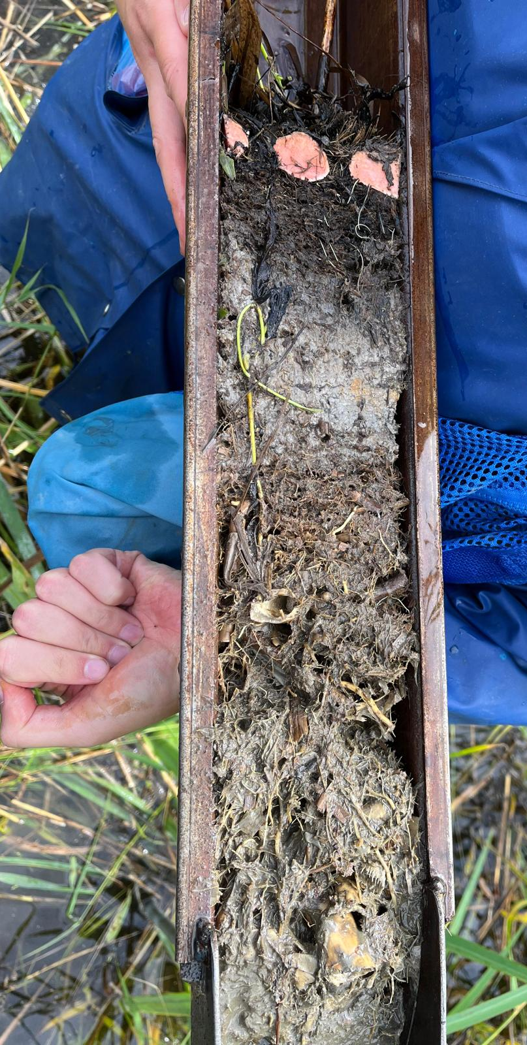
Common Reed (Phragmites australis)
Wetland grass (sedge, rush, or grass)
Dense stands (40-300 stems per m², 1-3m tall) and dense root systems (down to 1m depth)
Tolerance for a range of salinities and nutrient levels
Impacted by deep water depths, wave exposure, and presence of ice

Slide 7
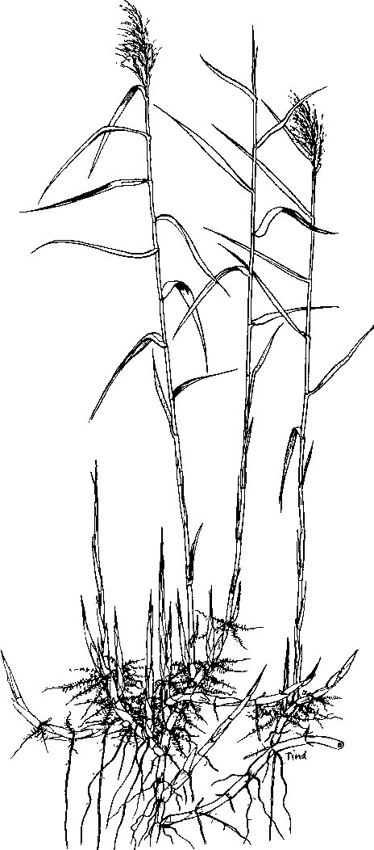
Competitive Advantages
Eutrophication = decreases competing plants and enables reeds to dominate a coastal habitat
Dense stands help crowd out other species
New stems can form from any lateral bud
New stems can form from rhizomes up to 10m away
Overwintering green buds protected in underground parts of the plant
Lifespan of rhizosphere 5-7 years
Drawing by K. Tind

Slide 8
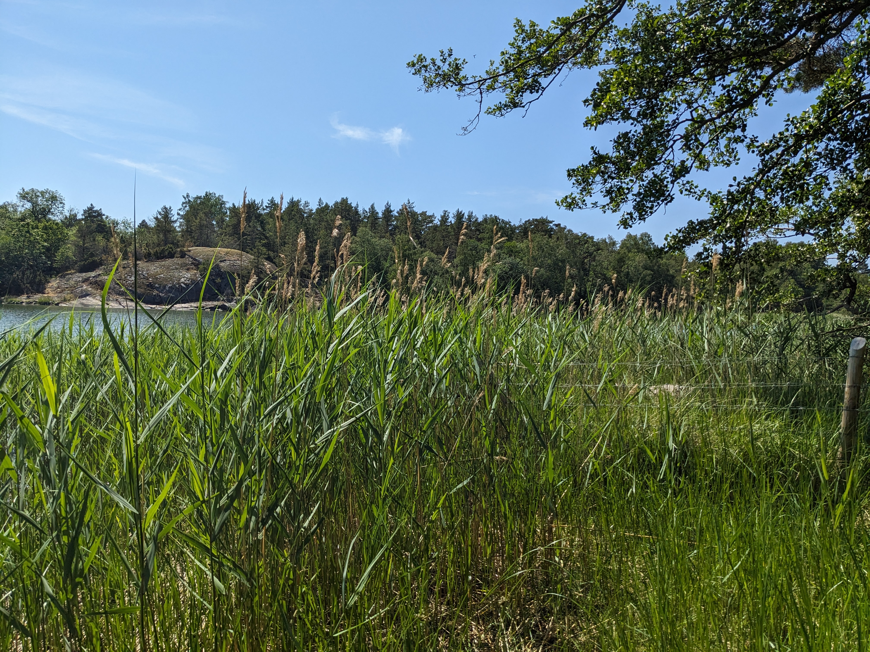
Reed in Coastal Ecosystems
Reed dominance = decreased plant biodiversity in coastal wetlands/ecosystems
Dense root systems collect sediment to build up coastal wetlands and collect nutrients from runoff
Reed beds provide habitat for nesting birds and fish species
Historically, reed beds in Finland managed more with grazing, etc.
Modern management has to take into account seasonality of cutting to reduce greenhouse gas emissions, reduce impact to nesting species, etc

Slide 9
Questions?

