Slide 1
Biopolymers upcycled from wood residues
Baltic Reed Hackathon, 14 February 2024

Slide 2
Antti Kämäräinen
M.Sc. (Agr. & For.), Forest Economics and Marketing, University of Helsinki, 2004
 | 2021- | Market Development Director
 | 2018-2021 | Sales Manager, Biocomposites & Circular Solutions
 | 2014-2018 | Consultant, Forest Industry & Biosolutions
 | 2001-2013 | Various positions (UPM Plywood 2001-2010, “NBD” 2010-2013)
https://www.linkedin.com/in/anttik/

Slide 3
Flows of Wood Material in Finland
In 2022, the total consumption of wood dry-matter was 36.8 million tonnes.
According to the forest sector’s mass balance, ~60% of all wood dry-matter ends up for energy generation.
Most of the wood dry-matter ending up in energy production consists of either
forest industry by-products or various wood residues, or
black liquor and other concentrated liquors from wood pulp industry
Source: LUKE

Slide 4
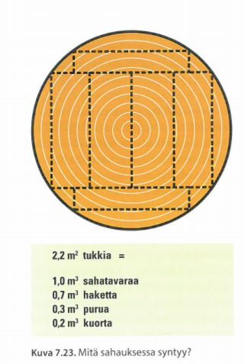
By-products of Sawmilling
Logs needed to produce one cubic meter of sawn goods varies from plant to plant. On average, about 2.2 m³ of logs are needed for 1 m³ of sawn goods.
2.2 m³ of logs needed to produce 1 m³ of sawn goods generates by-products as follows:
0.7 m³ (32%) of wood chips
0.3 m³ (14%) of sawdust
0.2 m³ (9%) of bark
Wood chips are an excellent raw material for the pulp and pulp industry.
Sawdust is used for the production of chipboard and pellets.
The bark is used as a fuel for energy, often supported by dry sawdust.
Image: Tapion taskukirja

Slide 5
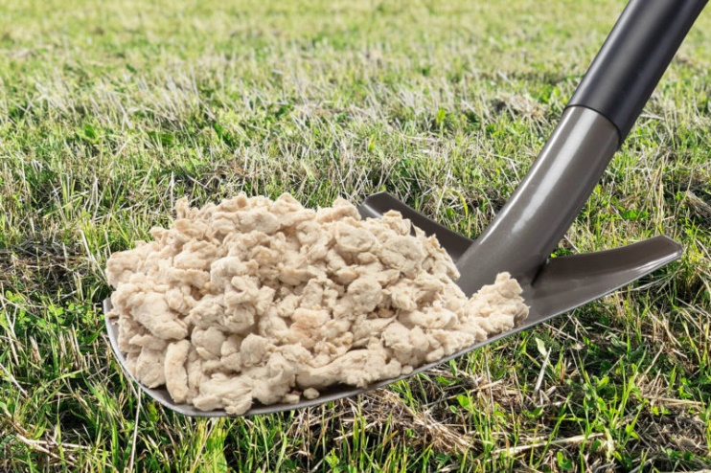
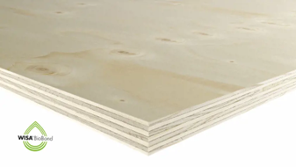
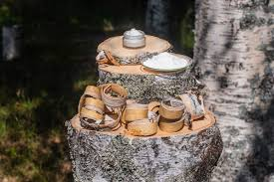
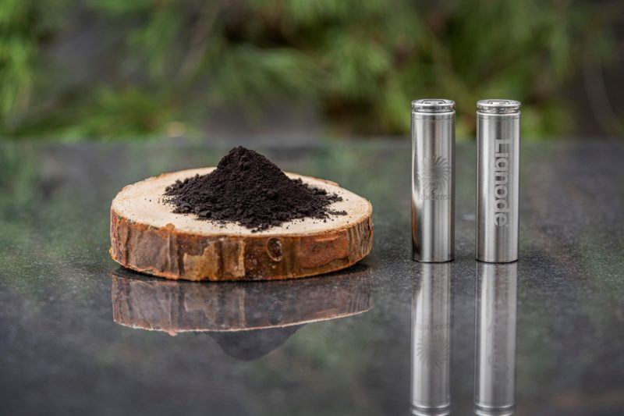
“Everything that can be made with fossil-based material today can be made from a tree tomorrow” – Stora Enso
Forest industry side streams are assuming an increasingly important role for the sector’s future. The industrial use of side streams means more careful utilization and more valuable uses of the wood felled from the forest.
Soilfood: Paperboard production side streams are converted for use in soil improvement. Their wood-based fibre product increases the content of organic matter in arable land and improves its water retention, as well as binding carbon in the soil.
UPM: In plywood production, a minimum of 50% of the fossil-based phenol in the plywood’s glue is replaced with the tree’s own natural adhesive lignin, a residue from pulp process.
Innomost: Natural and biodegradable compounds derived from industrial side streams by mechanical and physical methods and extracted and modified into multifunctional ingredients for cosmetic products.
Stora Enso: Lignin replaces the non-renewable graphite used in batteries. A lignin battery can be charged 2-3 times faster than a conventional graphite battery. The technology also allows a greater energy density, reducing the need for charging.

Slide 6
Uusi puu – New Wood
To see and learn more about wood-based innovations, please pay a visit to the Uusi puu – New Wood exhibition at the Finnish Museum of Technology (Viikintie 1, 00560 Helsinki).
The exhibition is open to the public until the end of March 2024.

Slide 7
Boreal Bioproducts / Montinutra Oy
Company name: Montinutra Oy
Auxiliary company name: Boreal Bioproducts
Established in 2018
7 FTE’s
Pilot Factory in Turku
Head Office in Espoo
Montinutra Pilot Plant in Turku

Slide 8
Background: Future Biorefinery JR2 Programme New solutions for biomass fractionation, 2011-2014
The main objective of FuBio JR2 was to establish a world-leading competence platform in the field of wood biorefinery R&D in Finland
Focus of FuBio JR2: Novel value chains, in which wood is refined into new materials & chemicals
New products from cellulose, lignin and hemicelluloses
New wood fractionation methods

Slide 9
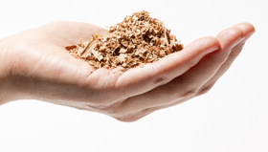
We offer natural polymers and extraction technology - and seek partners for commercialization
We offer
We look for
Natural polysaccharides, phenolics and thermally treated fibers
Water based biorefinery, integrated with forest industry
Joint development of product applications to commit commercial demand → JDA, LOI, Off-take
Partners who enable growth investments either by indication of the commercial commitment or through venturing

Slide 10
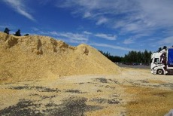
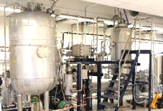
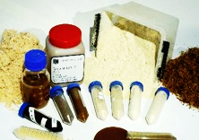
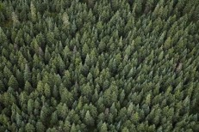
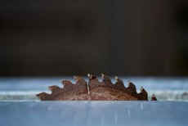
Wood residues upcycled to biopolymers
Side Streams
Sawdust, Bark
Biorefinery
Pressurized Hot Water Extraction
Bioproducts
Certified Forests
Sawmill or Pulp Mill
Supply Chain Partners

Slide 11
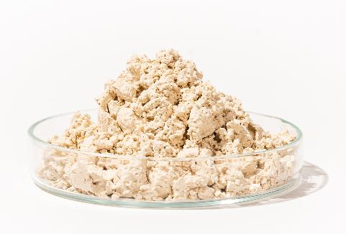
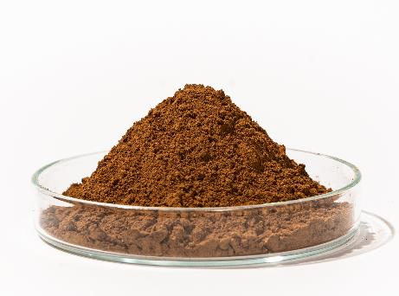
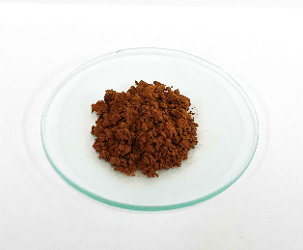
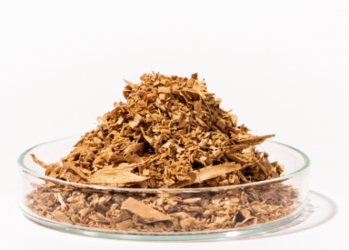
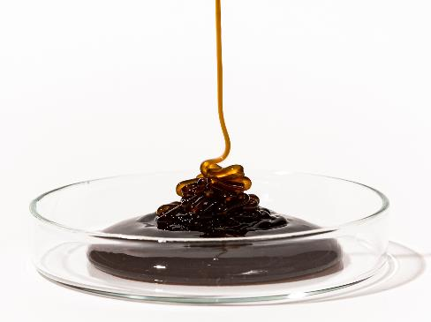
Presenting Boreal Bioproducts®
SpruceSugar™
Hemicellulose
SpruceLigno™
Lignin
Bark extracts
Tannin polyphenolics
SpruceFiber™
Lignocellulosic fiber
SpruceGlue™
Phenolic sugar

Slide 12
Our polysaccharides, phenolics and fibers
Product Grade | SpruceSugar™ LW, LL | SpruceLigno™ Crude, Ground | SpruceFiber™ Pure, Ground | SpruceGlue™ Crude
Description | Polysaccharide, rich in galactoglucomannan (GGM) | Lignin oligomers | Thermally treated fiber | Phenolics and oligosaccharides
Functionalities | Water soluble Grease barrier Viscosity reducer Film forming SPF boosting Surface activity modifying Chemically modifiable | Antioxidant UV-absorbent Good organoleptics No sulfur or soda Low ash | Larger surface area m2/g Absorbing capabilities Less temperature degradation Reduced ash, extractives ,VOC’s Hygienic, thermally sanitized | Mostly water soluble Hygroscopic Anti-oxidant Gluey
Molecular mass | 8 000 g/mol Mw | <5 000 g/mol Mw | Solid particles | <2 000 g/mol Mw
Lignin content | Grades 5% to <20%-w | >85%-w | >30%-w | >30 %-w
Formats | Concentrated ~50% in water Powdered | Crude (wet) Ground (dry) | Particles (classified sizes) Ground (dry) | Concentrate in water
+Tannin polyphenolic compound

Slide 13
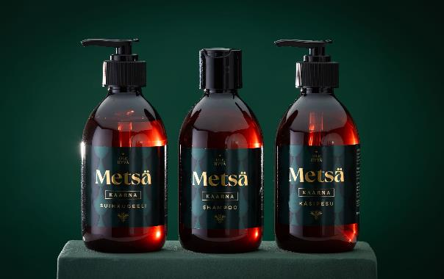
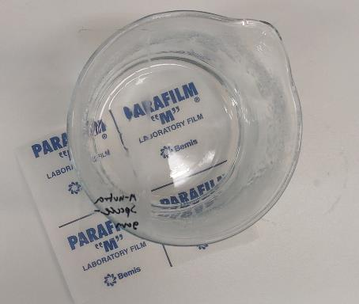
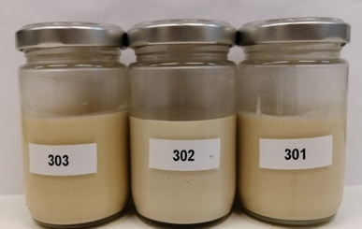
Applications developed with our partners
HAIR CARE
ANTI-FOG
BARRIER
SpruceSugar™
SpruceLigno™
SpruceSugar™
SUN CARE
GLUE
BINDER
SpruceGlue™
SpruceSugar™
SpruceTannin™
SpruceLigno™
SpruceSugar™
SpruceSugar™

Slide 14
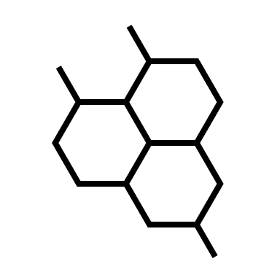
Focus on cosmetics and chemical industries to balance volume, value and time-to-market
Price EUR/kg
Short-term focus
Cosmetics formulations with product sales
Replacing fossil biopolymers in functional industrial chemicals with product sales
In the longer term, we will have several attractive markets
Food&Beverage, feed and active ingredients markets are attractive business verticals, but have longer time-to-market due to regulation
New markets are entered through product development in own R&D and with market specific partners
1 000
Health
Actives
>200 €/kg
Cosmetic
Active
+200 €/kg
100
Cosmetic
Functional
20-80 €/kg
10
FOCUS
Chemical
Functional
2-20 €/kg
Food & Bev
Functional
1-5 €/kg
1
Chemical
Platform
0-2 €/kg
10
100
1 000
+100 000
Market demand per product, t/a

Slide 15
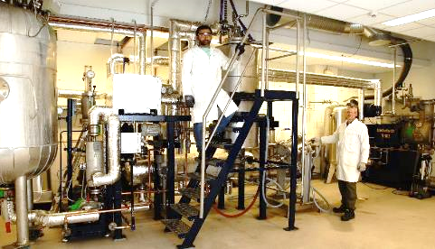
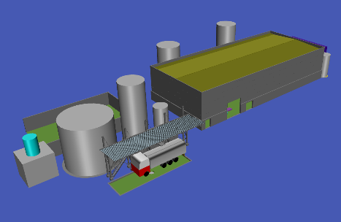
Market development → Plant commission 2026
Geographic expansion
Distribution
Off-takes
Pre-agreements
Industrial pilots
☑
First customers
2021
2022
2023
2024
2025
2026
2027
Pilot Plant
First-of-a-kind plant
Pre-A financing
☑
Plant design
☑
(Contract manufacturing)
Investment planning
Series-A financing
Construction
Technology readiness levels (TRL) https://ec.europa.eu/research/participants/data/ref/h2020/wp/2014_2015/annexes/h2020-wp1415-annex-g-trl_en.pdf

Slide 16
Climate friendly, natural and scalable technology
Reduction up to
-95% CO₂
footprint in comparison
to a fossil substitute
100%
Natural products
Wood residues
>150 000 000 ton
Sawmill residues
>20 000 000 ton
…in Europe
Residues of PEFC™️ and FSC© certified sources
Scenario: Cradle-to-gate, excl. intrinsic carbon. Also, wood residue’s supply chain CO₂ footprint included for real comparability. Comparison against latex binder of styrene-butydiene or acrylics.
FAO, European Union

Slide 17
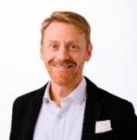
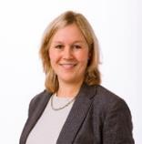
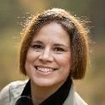
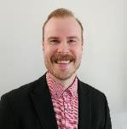
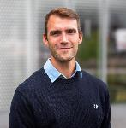
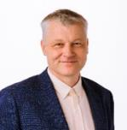
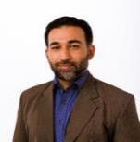
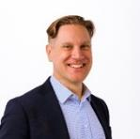
We are on a mission to succeed!
Company
Development
Technology
Market
Jaakko Pajunen
Managing Director
MSc Technology
Ann-Sofie Fonsen
Director
PhD Wood Chemistry
Aurelie Laloeuf
Sr Specialist
PhD Chemistry
Tony Tiainen
Manager
PhD Chemistry
Alexander Henn
Manager
DSc Chemistry
Pertti Tiitola
Director
BSc Engineering
Asim Mahmood
Process
MSc Process Chemistry
Antti Kämäräinen
Development
MSc Forestry
Over 15 years career in business development of publicly listed companies.
Expertise in organic chemistry and poly-saccharide modification.
Cosmetics ingredient and product development professional.
Synthesis, modification and development of hybrid materials.
Synthesis, modification of biopolymers and phenolics.
Over 25 years of technology expertise in scale up from pilot to commercial scale.
Experienced in chemical experiments and quality control.
Over 20 years in international B2B sales of novel forest products.
Looking to broaden the team with application R&D, engineering and SGA towards the plant implementation.

Slide 18
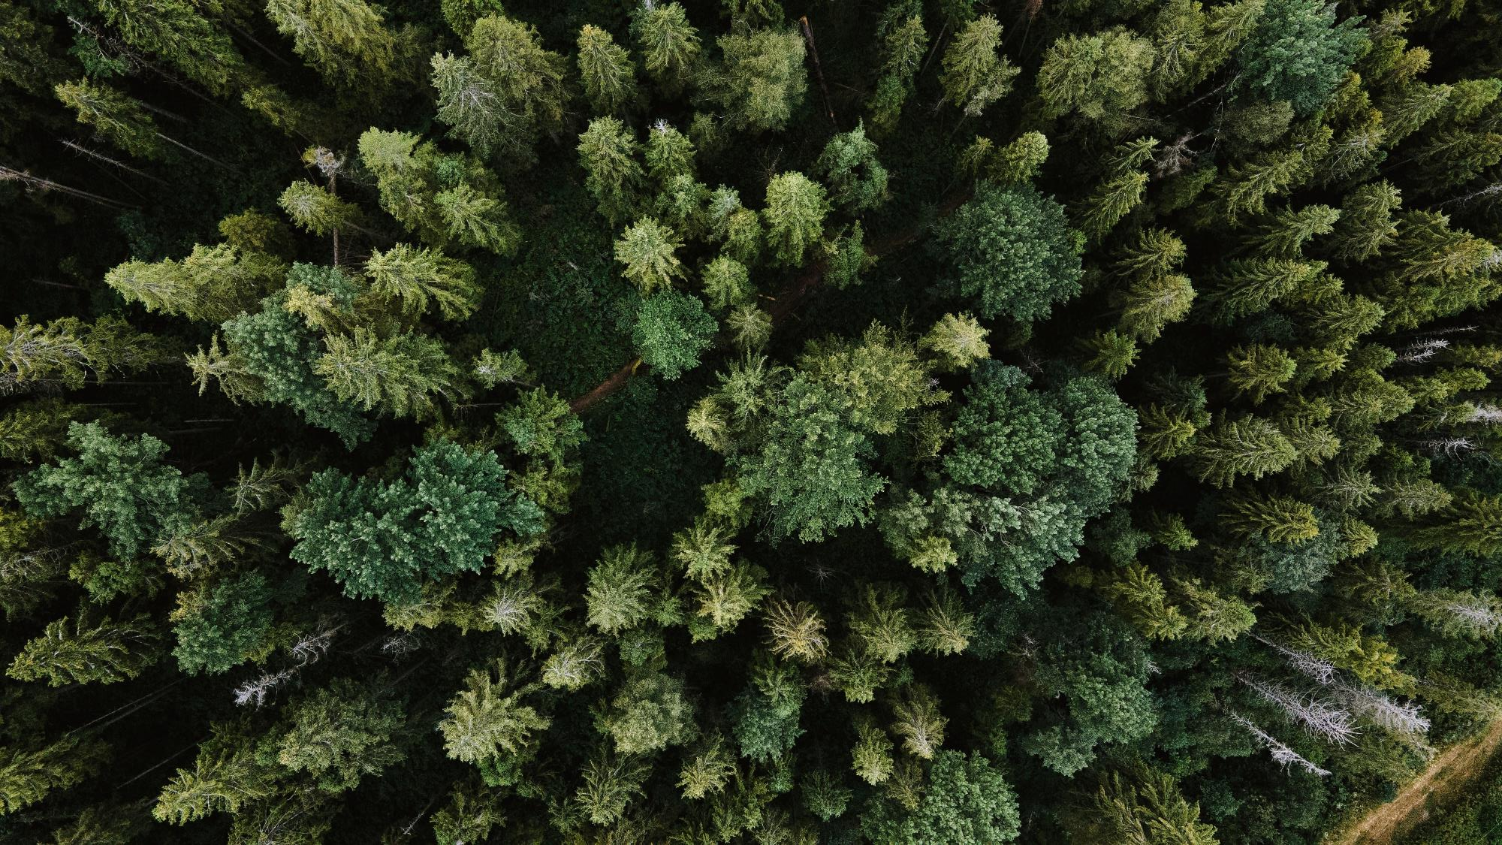
Ingredients of the future,
from residues of today.
Please contact:
Antti Kämäräinen, Market Development Director
antti@borealbioproducts.com
+358 40 546 6959

